Slide 1
Harrison’s Vacation to atlantic beach, north carolina
By Harrison Fouch

Slide 2
This spring break, my family went on a vacation to Atlantic Beach, North Carolina. We drove there and stayed from March 16th to March 24th. We ate at many different restaurants during our stay in Atlantic Beach, and I took pictures of most of the food I ate. All we did during our stay was eat, sleep, swim, and play cards. I enjoyed my stay at Atlantic Beach because it allowed me to relax.

Slide 3
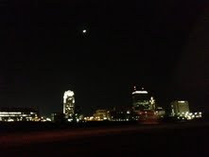
Hotel
We drove a little bit over halfway our first night on the trip. We stayed in a hotel near Winston-Salem, North Carolina.

Slide 4
BIKER GANG
The morning after we stayed in the hotel, we continued our drive to Atlantic Beach. On our way there, we were surrounded by a biker gang.

Slide 5
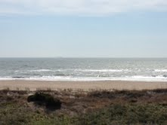
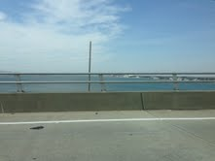
View from our condo/road
Once we arrived at our condo, we were treated to a wonderful view of the beach.
We also enjoyed a great view of the ocean on the drive there.

Slide 6
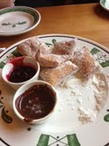
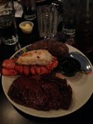
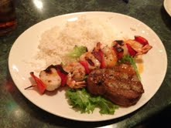
food
Once we arrived in Atlantic Beach, we ate at many different restaurants including Olive Garden, the Watermark Grill, and Amos Mosquitos.

Slide 7
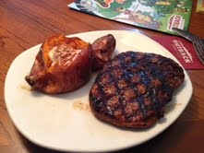
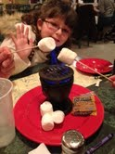
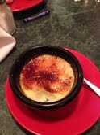
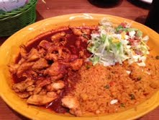
Food continued
We also ate at Outback Steakhouse and a Mexican restaurant called El Zarape.

Slide 8
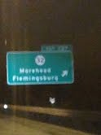
end
We enjoyed our stay at Atlantic Beach and plan to return as soon as possible, but we were glad to return home.

