Slide 1
Having diabetes by: connor

Slide 2
Diabetes is a common disease diagnosed as type 1 or type 2 type 1 is the kind I have. When you have type 1, you are required to give shots everyday along with checking your sugar, where as with having type 2 you just have to take medication and keep a check on your health.

Slide 3
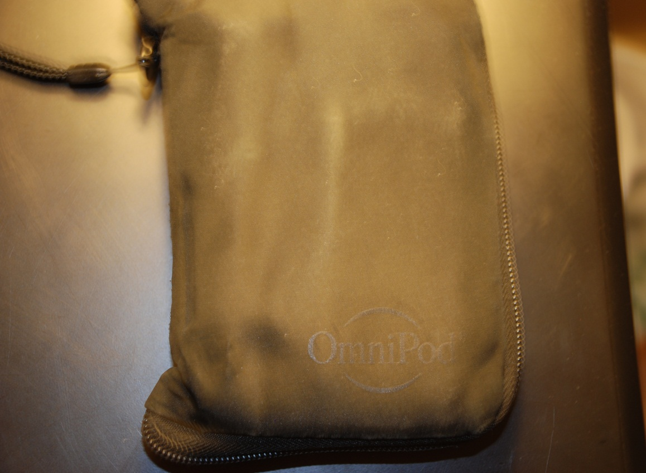
this is what I use to keep my readings in check

Slide 4
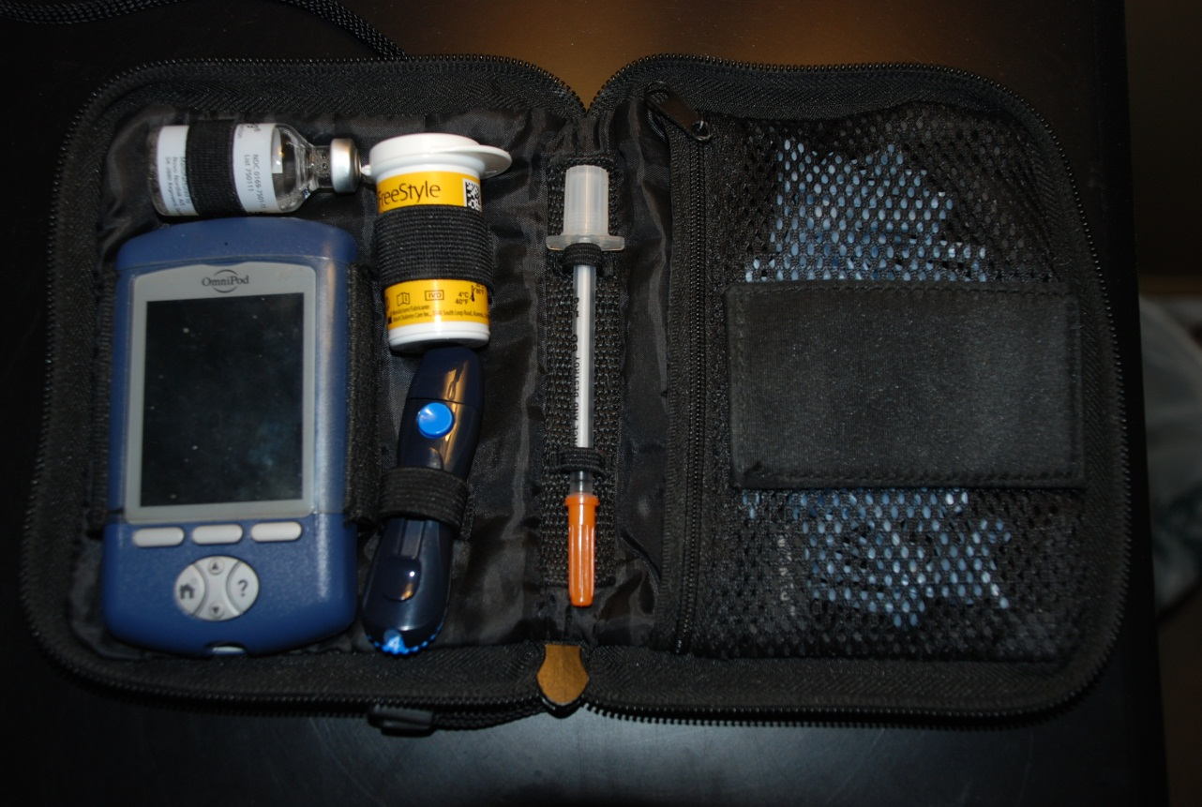
My kit consists of a meter, test strips, lancets, and insulin.

Slide 5
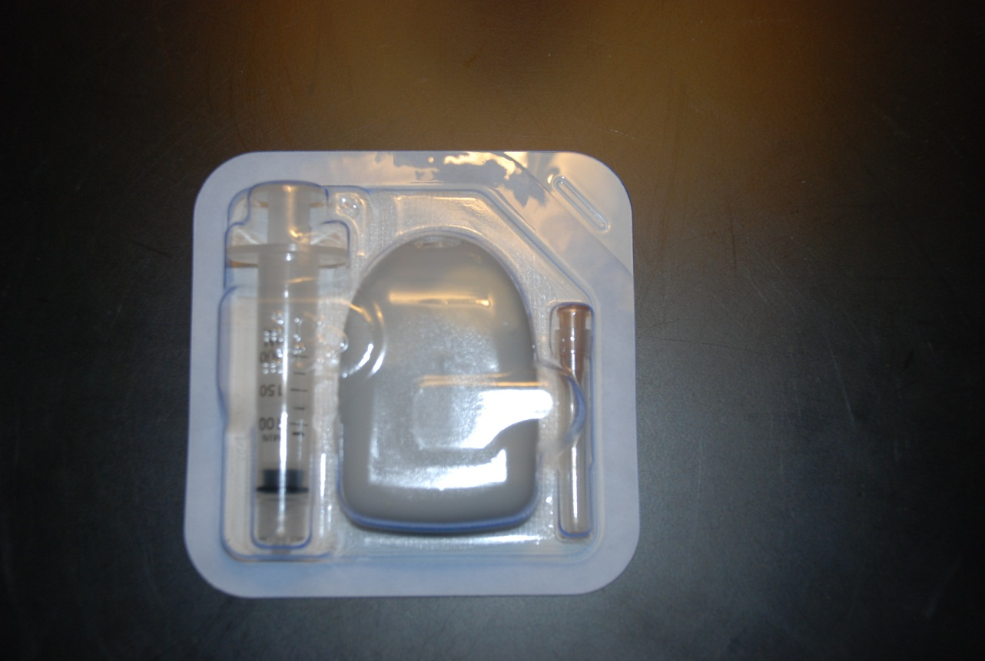
This is my insulin pump.

Slide 6
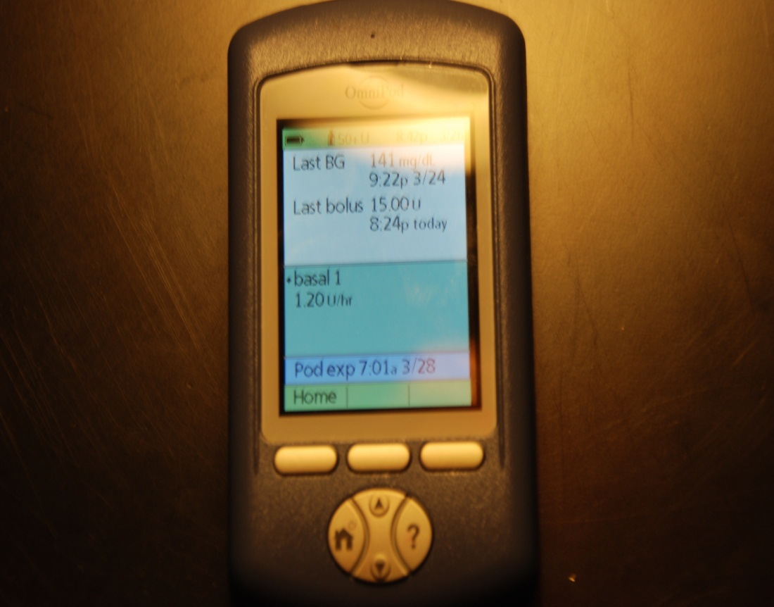
This is my meter that I use to check my sugar. (it’s awesome)

Slide 7
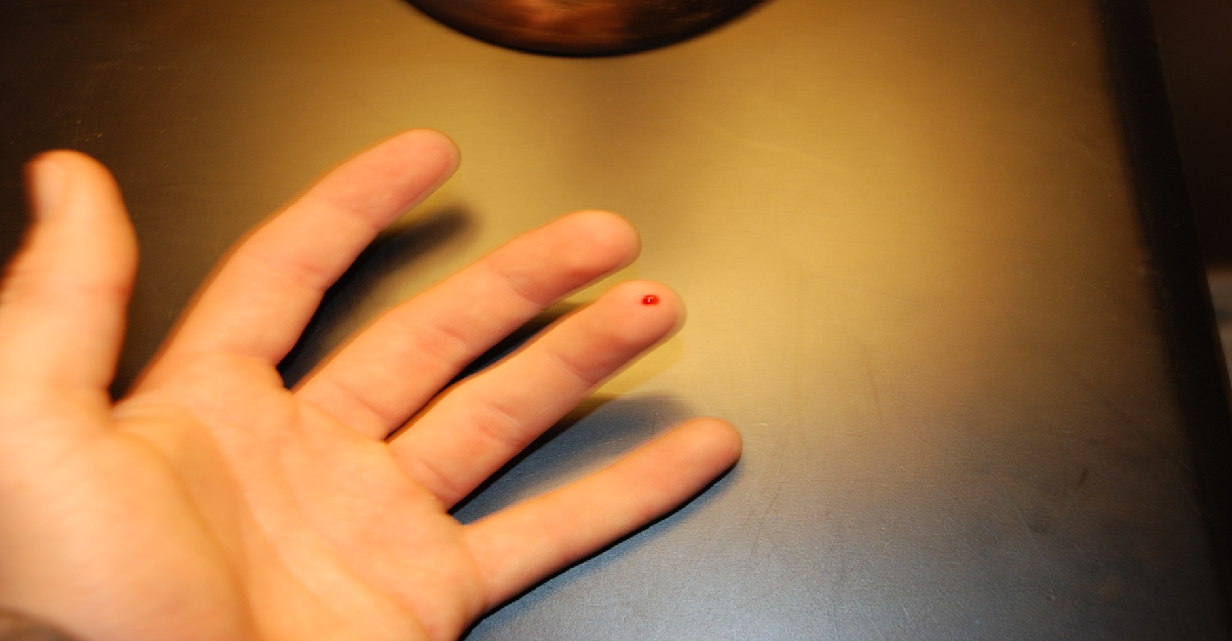
This is me checking my sugar.

Slide 8
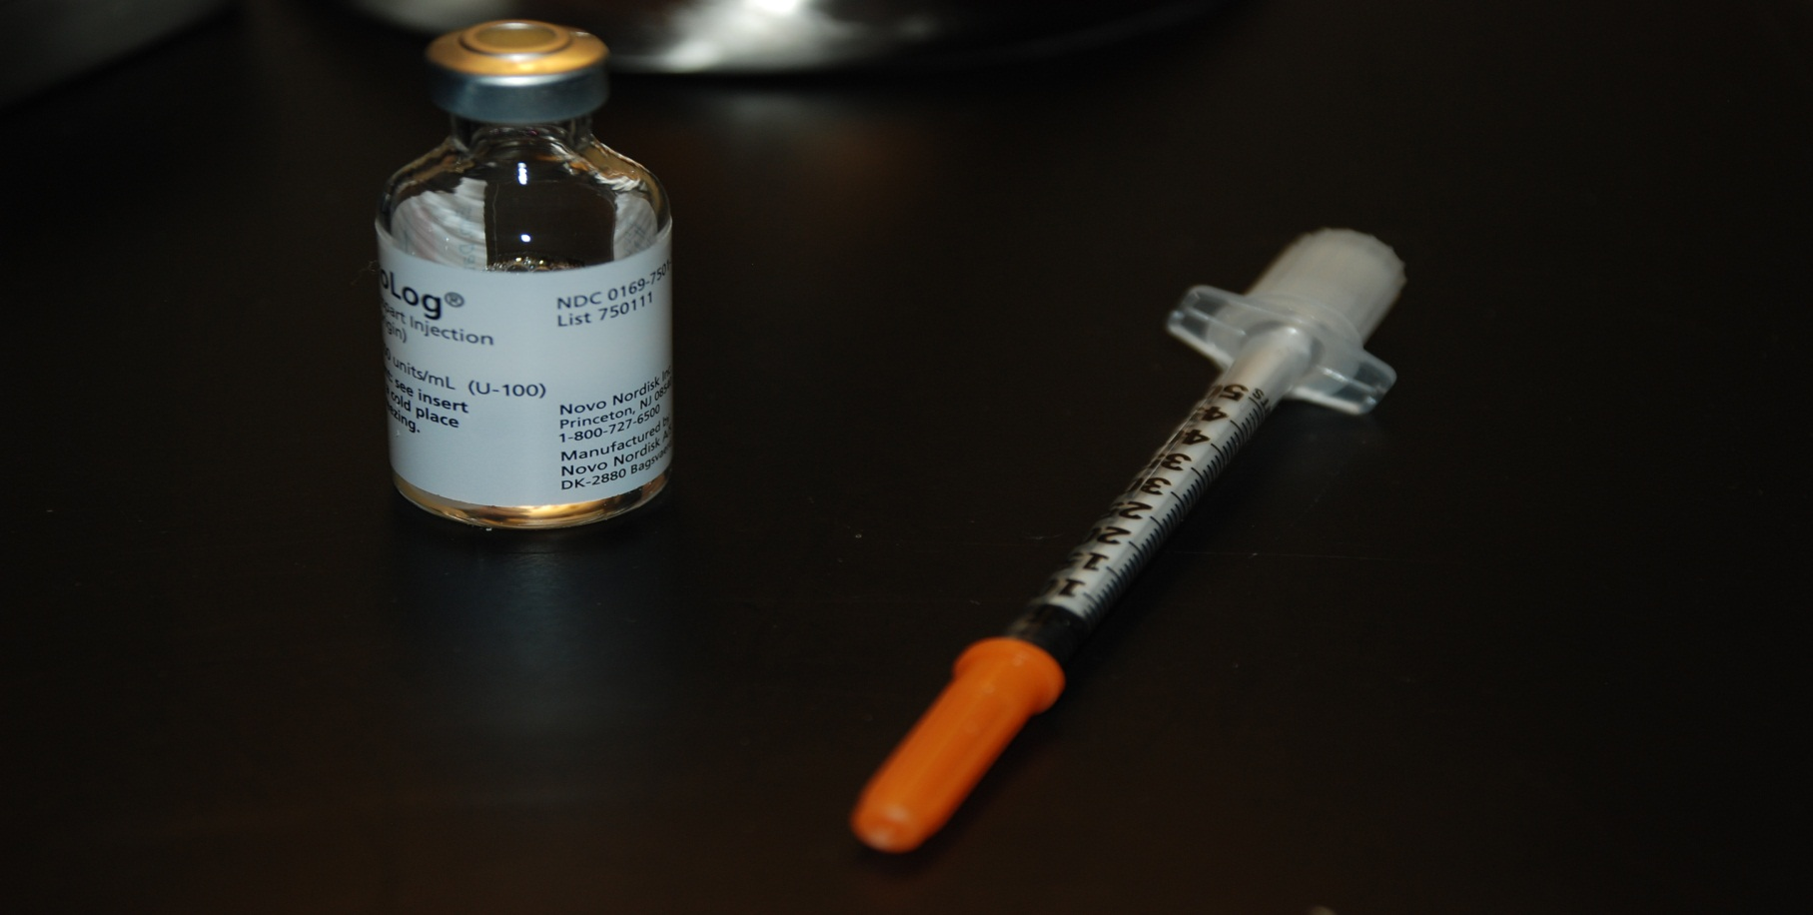
This is my novolog(insulin) and my syringe that I give my shots with.

Slide 9
Diabetes camp!

Slide 10
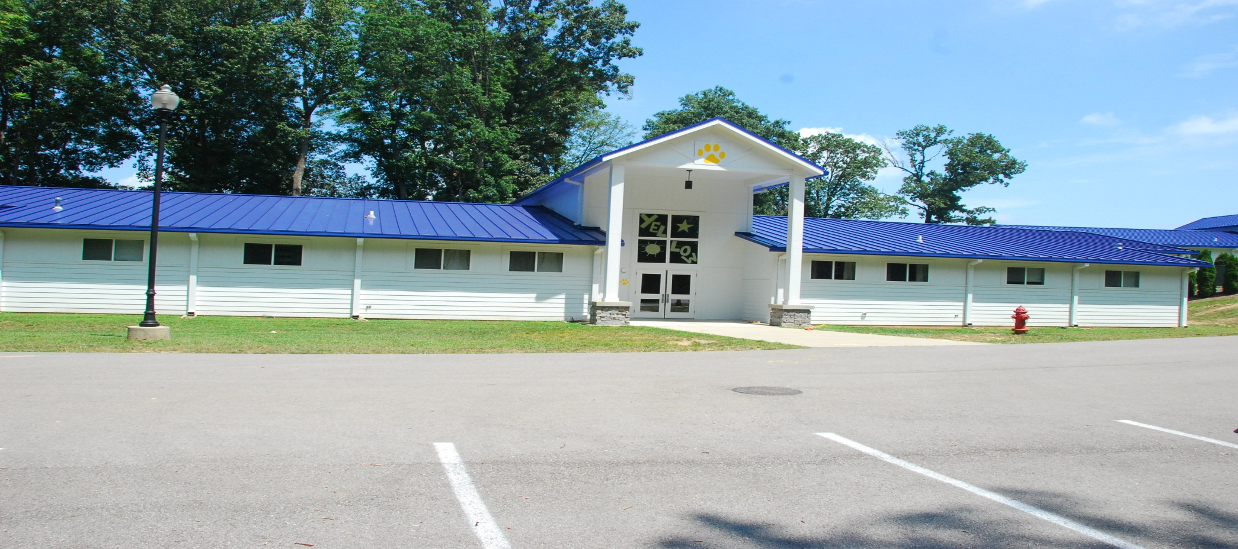
This is the dorm I stayed in.

Slide 11

Camp meeting the first night.

Slide 12
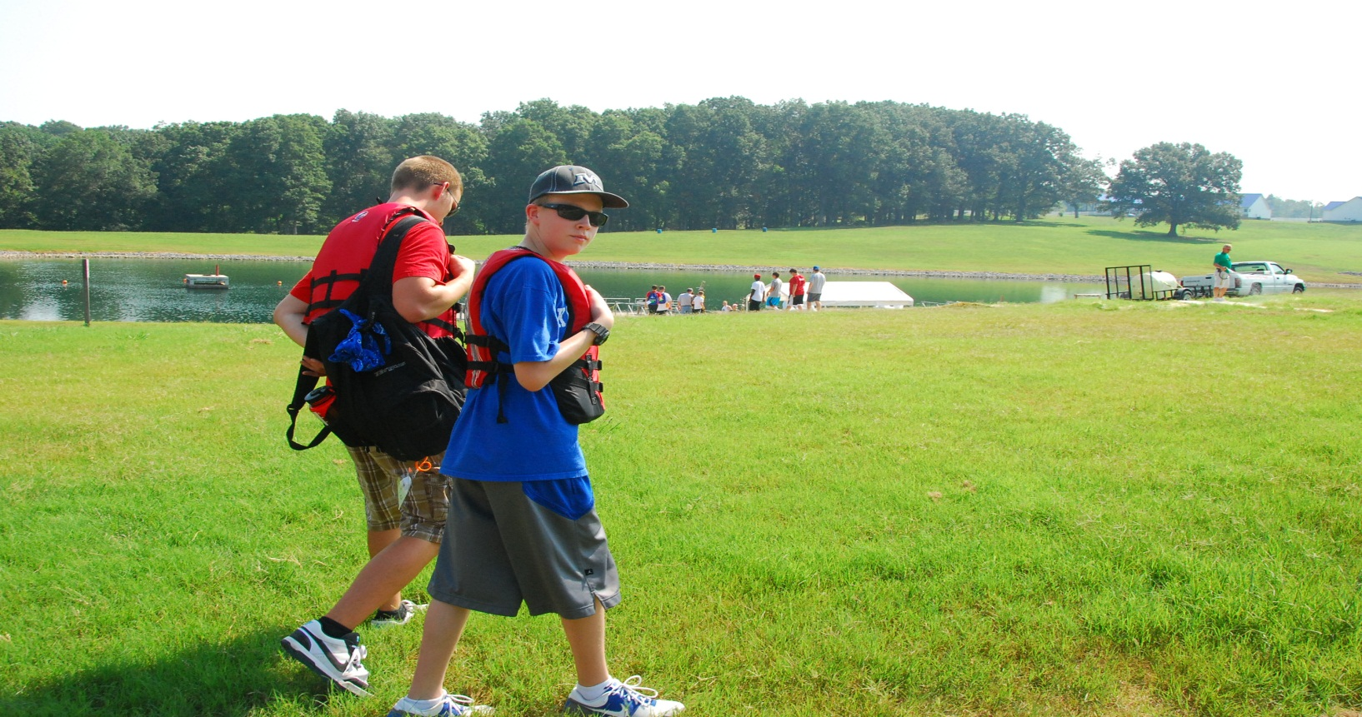
day on the lake, we got wet.

Slide 13
You got any questions?

