Slide 1
5.6 Deductive Proofs

Slide 2
Introduction
When talking about deductive proofs, we use a lot of “hoity, toity” Latin words.
Just for fun:
Here are some Latin phrases that you may recall.
E Pluribus unum
Cogito ergo sum
Quod erat demonstrandum
What do you think these phrases mean?

Slide 3
Answers
E Pluribus unum- One from many
Cogito ergo sum- I think, therefore I am.
Quod erat demonstrandum- That which was to be demonstrated.

Slide 4
Four types of proofs
Transitivity
Modus Ponens
Modus Tollens
Law of Deduction

Slide 5
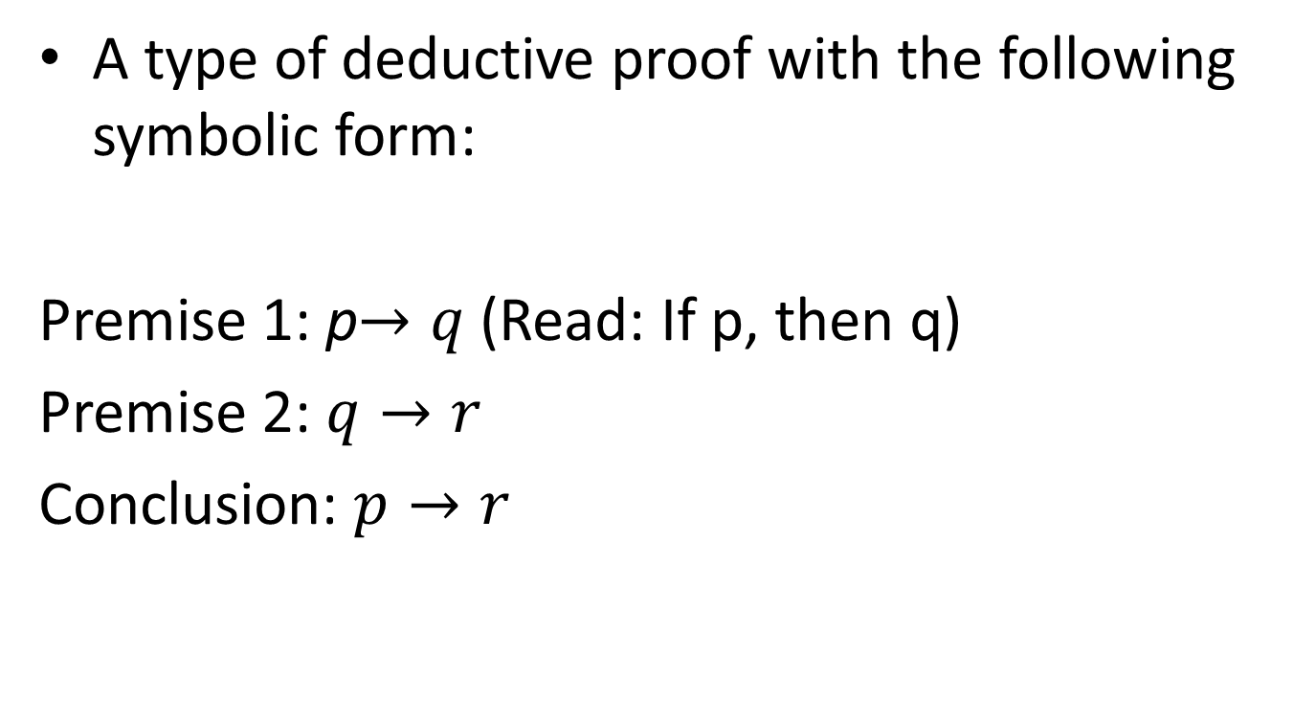
Transitivity
A type of deductive proof with the following symbolic form:
Premise 1: p$→q$ (Read: If p, then q)
Premise 2: $q→r$
Conclusion: $p→r$

Slide 6
Example 1
Premise 1: $(p→q)$If an animal is a bat, then it is nocturnal.
Premise 2: $(q →r)$If an animal is nocturnal, then it hunts at night.
Conclusion: $\left(p→r\right)$ If an animal is a bat, then it hunts at night.

Slide 7
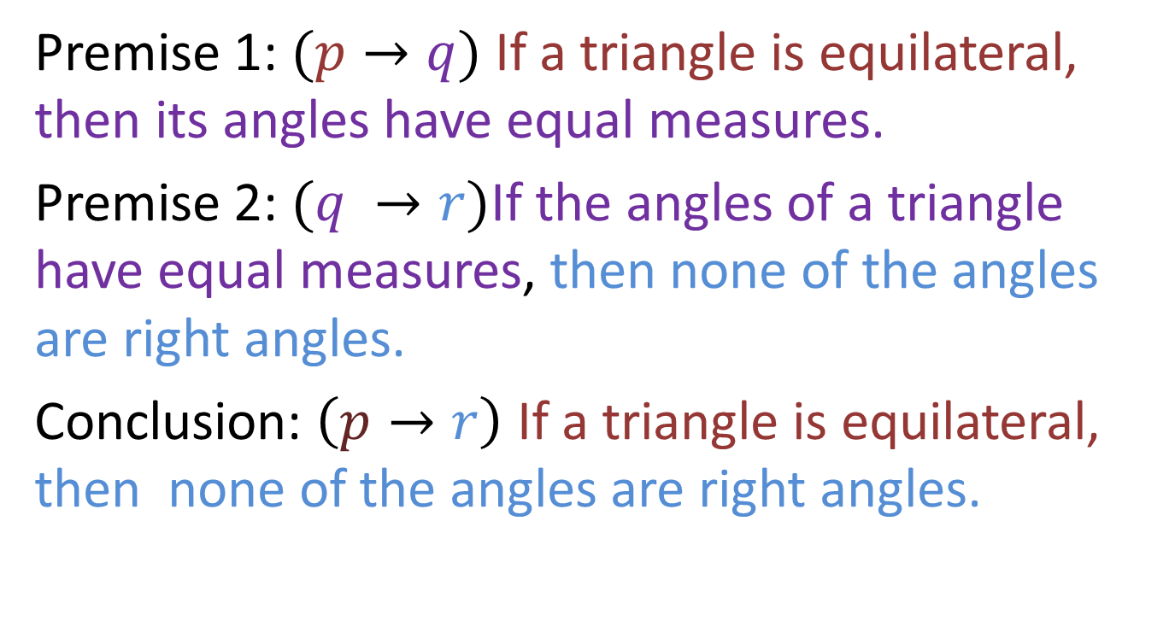
Example 2
Premise 1: $(p→q)$If a triangle is equilateral, then its angles have equal measures.
Premise 2: $(q →r)$If the angles of a triangle have equal measures, then none of the angles are right angles.
Conclusion: $\left(p→r\right)$ If a triangle is equilateral, then none of the angles are right angles.

Slide 8
Create Your Own
Create your own example of a transitive proof by following the symbolic form below.
Premise 1: p$→q$
Premise 2: $q→r$
Conclusion: $p→r$

Slide 9
Keys to Remember
A transitivity argument reduces two or more conditional statements (If p, then q statements) to just one conditional.

Slide 10
Modus Ponens
Modus Ponens is a method of deductive proof with the following symbolic form.
Premise 1: $p→q$
Premise 2: $p$
Conclusion: $q$

Slide 11
Example 1
Premise 1: $\left(p→q\right)$ If a mammal is a dinosaur, then it is extinct.
Premise 2: $p$ A T-Rex is a dinosaur.
Conclusion: $q$ A T-Rex is extinct.

Slide 12
Example 2:
Premise 1: $\left(p→q\right)$ If it rains today, the ball game will be canceled.
Premise 2: $p$ It rained.
Conclusion: $q$ The ball game was canceled.

Slide 13
Create Your Own
Create your own modus ponens proof using the symbolic form below.
Premise 1: $p→q$
Premise 2: $p$
Conclusion: $q$

Slide 14
Keys to Remember
The word “Modus” is Latin for mode. The term “Ponens” is Latin for “asserting.” Thus, “modus ponens” is the “mode of asserting proof” or the “mode of declaring truth.”
Modus Ponens does not use the inverses of p and q.

Slide 15
Modus Tollens
Modus Tollens is a method of deductive proof with the following symbolic form.
Premise 1: $\left(p→q\right)$
Premise 2: ~$q$
Conclusion: ~$p$

Slide 16
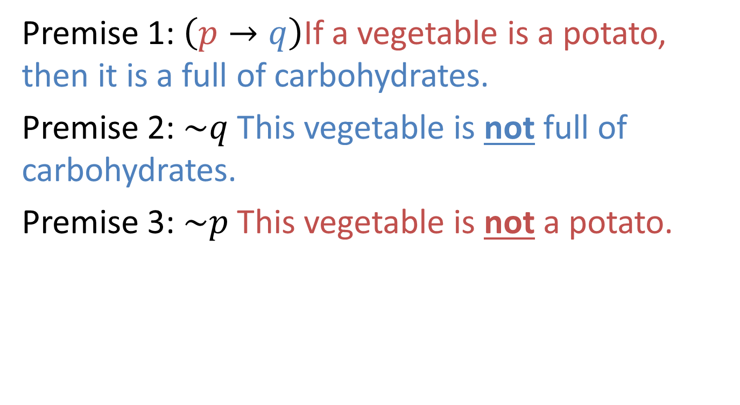
Example 1
Premise 1: $\left(p→q\right)$If a vegetable is a potato, then it is a full of carbohydrates.
Premise 2: $\sim q$This vegetable is not full of carbohydrates.
Premise 3: $\sim p$This vegetable is not a potato.

Slide 17
Example 2
Premise 1: $\left(p→q\right)$If a rectangle is a square, then it has congruent side lengths.
Premise 2: $\sim q$ The rectangle does not have congruent side lengths.
Premise 3: $\sim p$The rectangle is not a square.

Slide 18
Create Your Own
Create your own modus tollens proof using the symbolic form below:
Premise 1: $\left(p→q\right)$
Premise 2: ~$q$
Conclusion: ~$p$

Slide 19
Key to Remember
“Tollens” means denying or taking away, so modus tollens is denying the truth.
Tollens deals with the ~ “not” symbol or the inverses of p and q.

Slide 20
Law of Deduction
The Law of Deduction is a method of deductive proof with the following symbolic form:
Premise 1: $p$(assumed true)
$q_{1}$(statements known to be true)
$q_{2}$….
Deduced from premises:
$r$
Conclusion: $p→q$

Slide 21
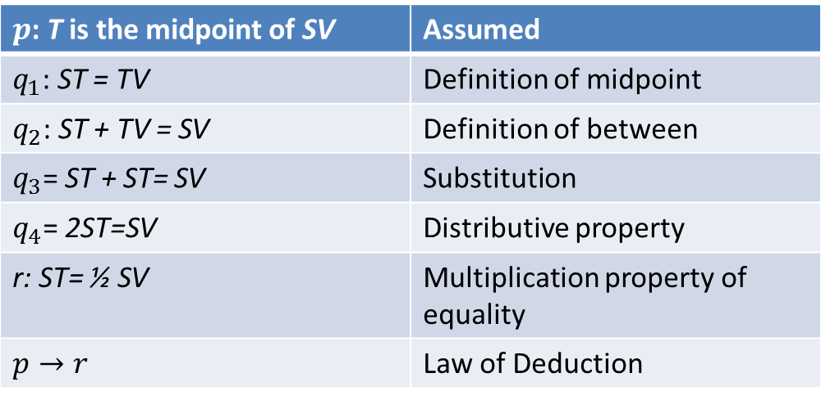
Example 1
Prove: If T is the midpoint of line SV, then line segment ST = ½ SV
$p$: T is the midpoint of SV | Assumed
$q_{1}$: ST = TV | Definition of midpoint
$q_{2}$: ST + TV = SV | Definition of between
$q_{3}$= ST + ST= SV | Substitution
$q_{4}$= 2ST=SV | Distributive property
r: ST= ½ SV | Multiplication property of equality
$$p→r$$ | Law of Deduction

Slide 22
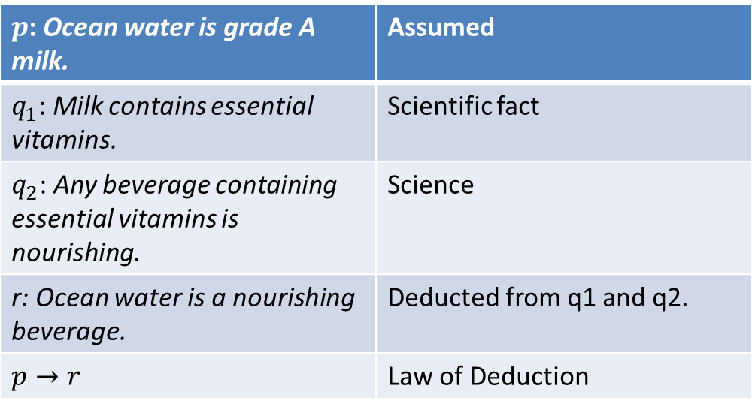
Example 2
Prove: “If ocean water is grade A milk, then ocean water is a nourishing beverage.”
$p$: Ocean water is grade A milk. | Assumed
$q_{1}$: Milk contains essential vitamins. | Scientific fact
$q_{2}$: Any beverage containing essential vitamins is nourishing. | Science
r: Ocean water is a nourishing beverage. | Deducted from q1 and q2.
$$p→r$$ | Law of Deduction

Slide 23
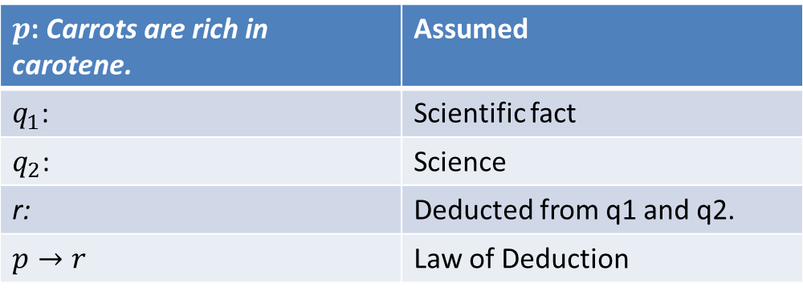
Create Your Own Example
Use the given statement to complete the table. Prove: If carrots are rich in carotene, then carrots are good for your eyesight.
$p$: Carrots are rich in carotene. | Assumed
$q_{1}$: | Scientific fact
$q_{2}$: | Science
r: | Deducted from q1 and q2.
$$p→r$$ | Law of Deduction

Slide 24
Keys to Remember
The Law of Deduction is the basis for all others proofs throughout the rest of our book.
The Law of Deduction builds on what we know to be true in order to proof statements.

Slide 25
Practice
State the form of deductive reasoning in the following.
If I drive on slick roads, then I will have to reduce my speed. The roads are slick. I will have to reduce my speed.

Slide 26
Answer
Modus Ponens

Slide 27
Practice
State the form of deductive reasoning in the following.
If I smell something burning, I need to turn the oven off. I did not turn the oven off. I did not smell anything burning.

Slide 28
Answer
Modus Tollens

Slide 29
Practice
State the form of deductive reasoning in the following.
If you study for the ACT, then you will get a better score. If you get a better score, then you will get into a better college. If you study for the ACT, then you will get into a better college.

Slide 30
Answer
Transitivity

Slide 31
Practice
State the form of deductive reasoning in the following.
A square is a polygon. Every square has congruent sides. A polygon with congruent sides is called regular. Therefore, a square is a regular polygon.

Slide 32
Answer
Law of deduction

Slide 33
Practice
State the form of deductive reasoning in the following.
A church is a non-profit organization. All non-profit organizations have to follow laws to distribute money. A church must follow laws to distribute money.

Slide 34
Transitivity

Slide 35
Practice
State the form of deductive reasoning in the following.
If I drink too much caffeine, then I can become addicted to caffeine. I am not addicted to caffeine. I do not drink too much caffeine.

Slide 36
Modus Tollens

