Slide 1
Summer 2012
Tyler Lambert}

Slide 2
I use to live in D.C.. In 8th grade we went there. It was with Simons Middle School in Fleming County, Kentucky. I did and did not enjoy the trip , because in D.C. we almost had three people arrested and one kicked out of school. But the beach was nice until my phone got wet and was damaged. In D.C. we did nothing fun, but I liked the beach. How I got to D.C. was in a tour bus and we drove to the beach.

Slide 3
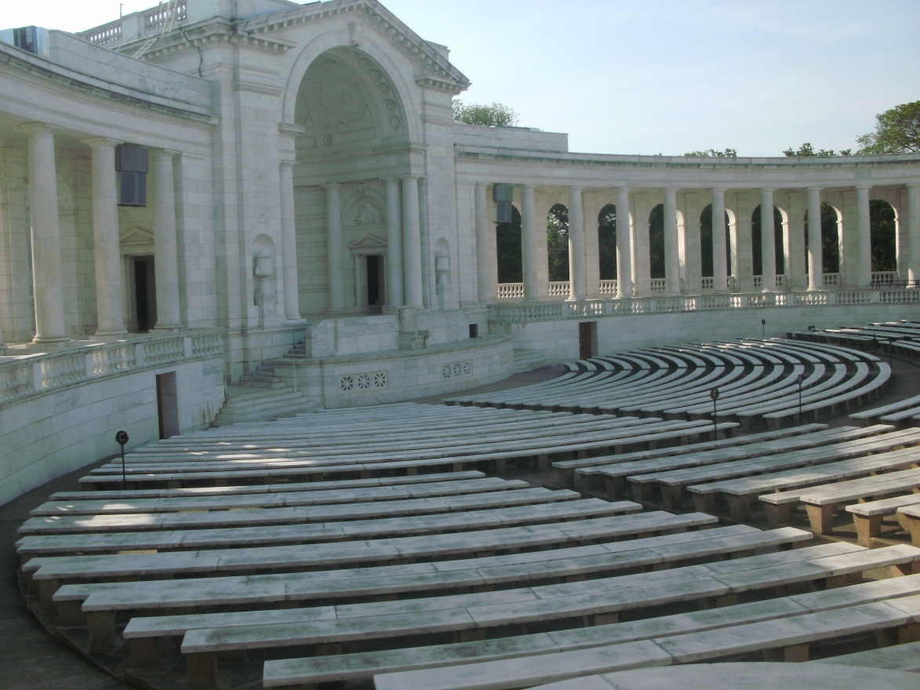
This is at Arlington Cemetery, this is where they have some events. Under the stage they have apartments for the changing of the guards and their families.

Slide 4
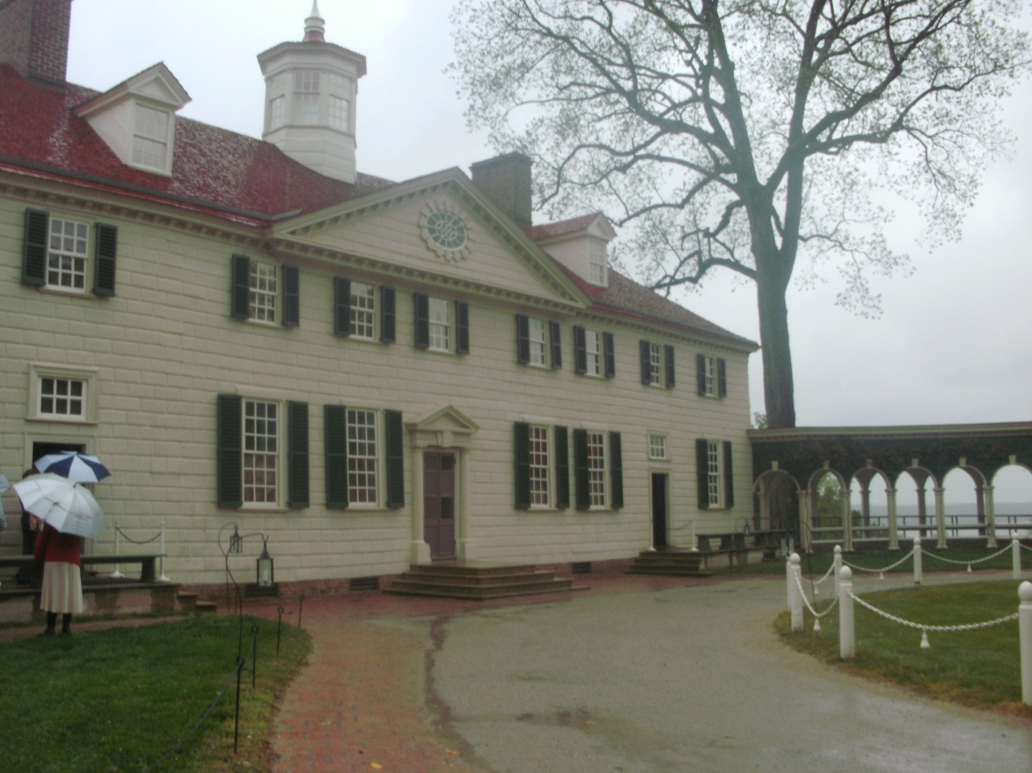
This is Mt. Vernon, home of George Washgtion our 1st President.

Slide 5
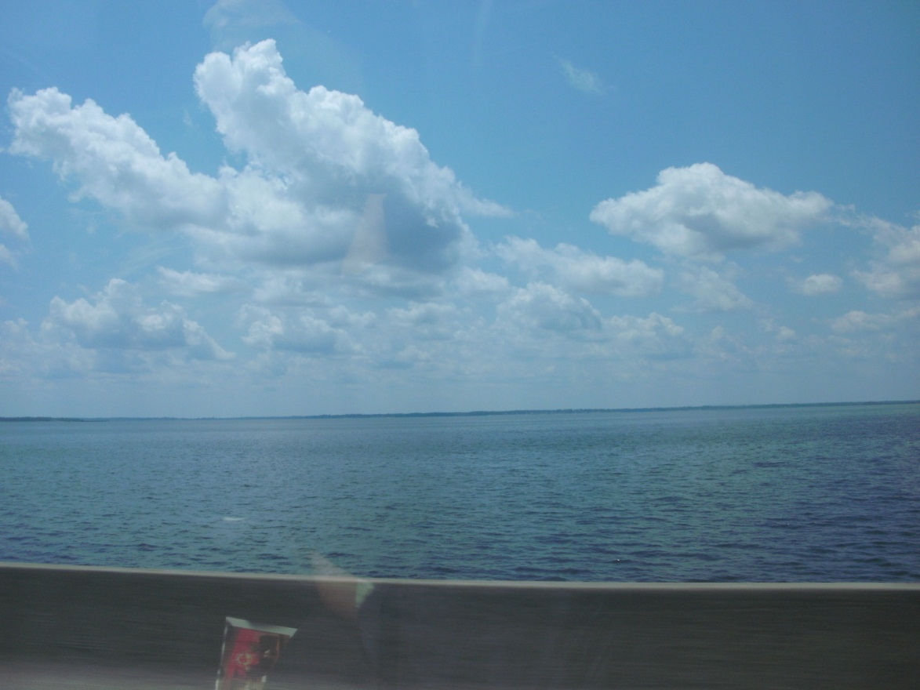
This is a view from the Chesapeake Bay bridge. We drove under water three times to get to the end of it.

Slide 6
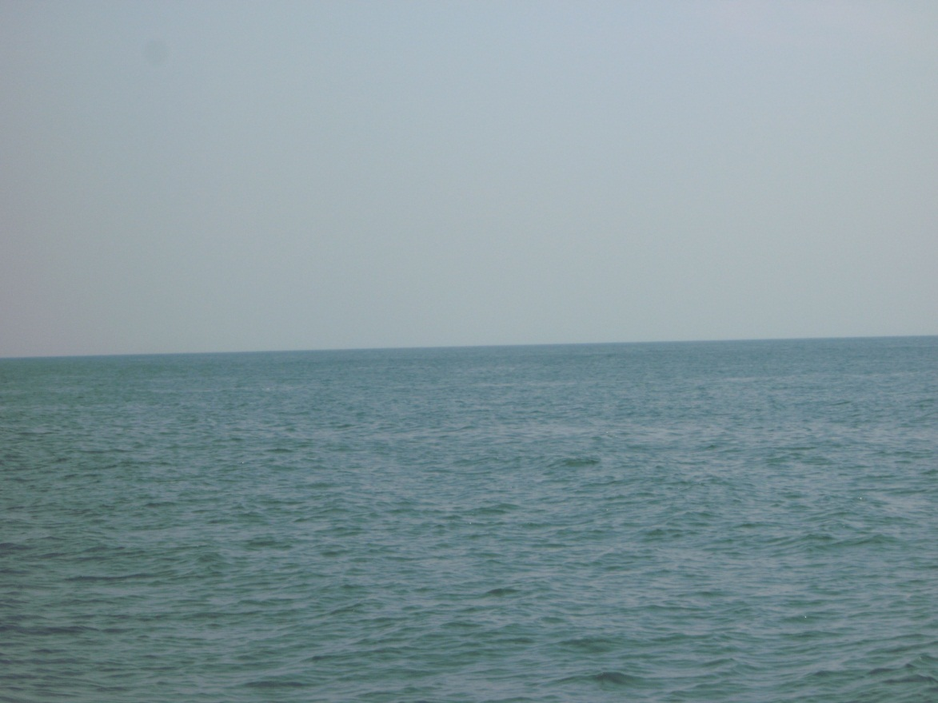
This is a view from the cruise we took this summer. We took two cruises.

Slide 7
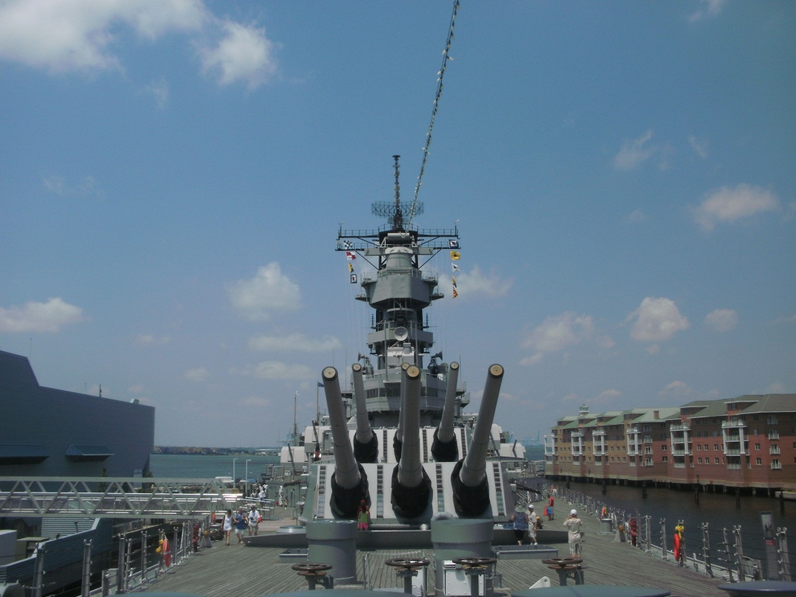
This is at Norfolk. This ship is the USS Wisconsin. It is now at Norfolk for people to tour.

Slide 8
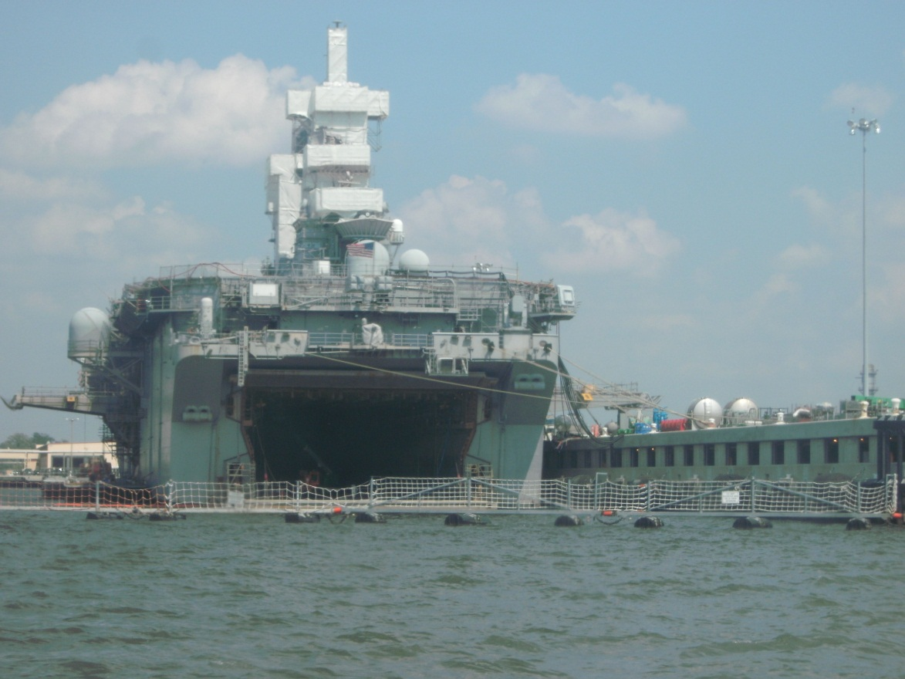
This is one of the ships that we saw during our cruise. This ship is the USS George W. Bush.

Slide 9
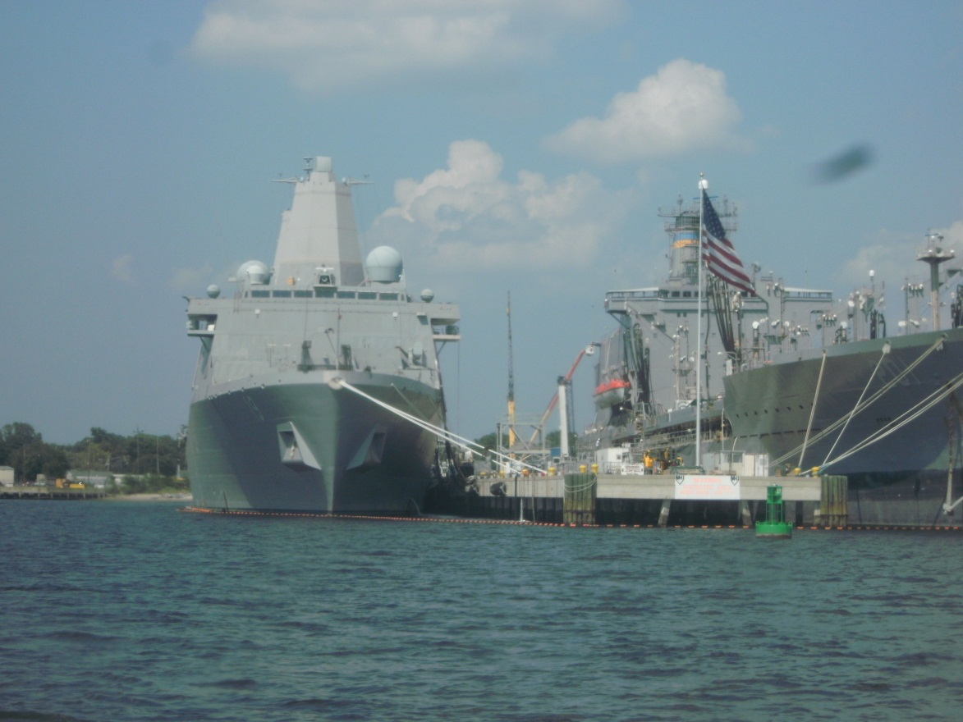
We also saw this other to ship during the cruise.

Slide 10
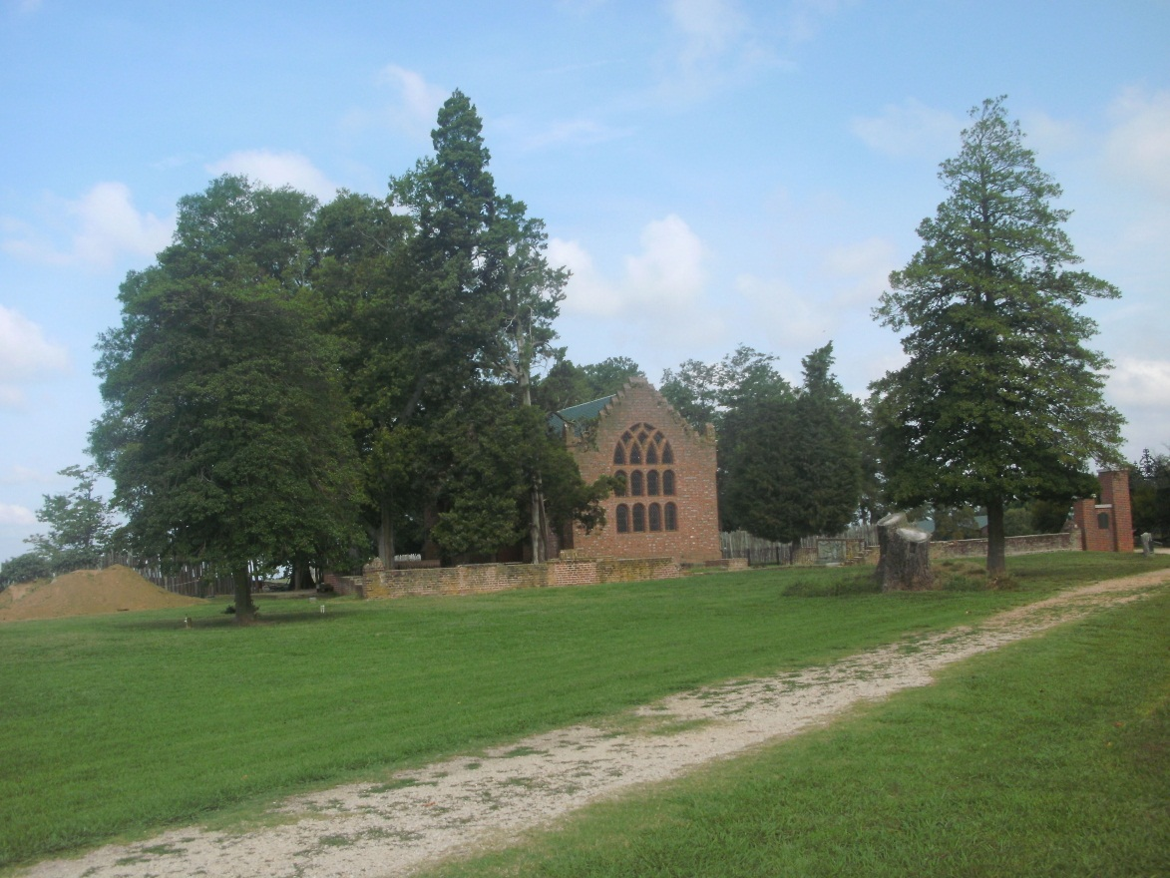
This is the church at Jamestown. Jamestown was the first settlement.

Slide 11
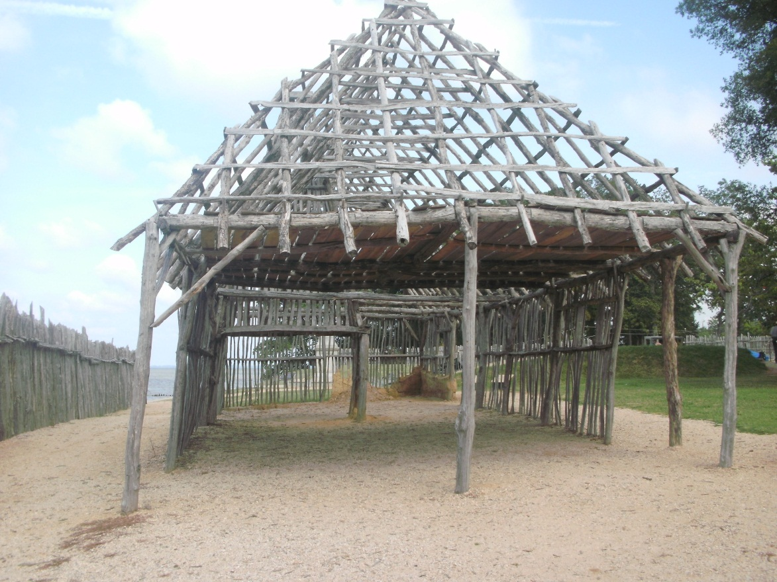
This is an replica of an old house. In 2007 Queen Elisabeth the one in office now went to visit Jamestown.

