Slide 1
Things I like!
By: Kiley Smith

Slide 2
Me!!!
My name is Kiley Smith. I am a 14 year old freshman at Lakeside Christian Academy. This is my first year at this school. I have a younger brother named Hunter. And am a member of a family of four. I don’t really play any sports currently, I prefer to focus on academics. This is part of the reason I chose to do this photo essay on things that I like, because there isn’t much about me to tell about. I like a lot of things, but these are just a few of my favorites.

Slide 3
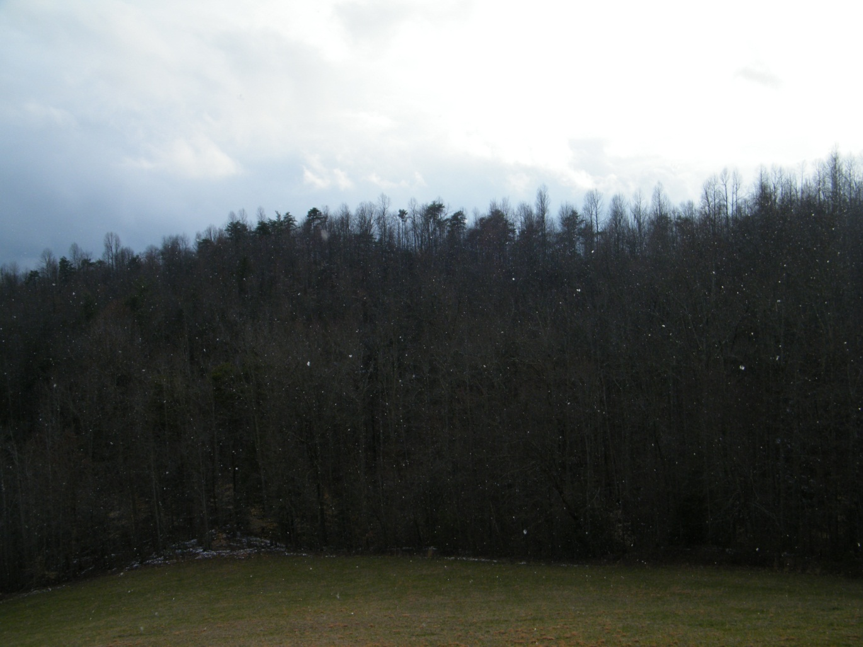
Snow!
*Snow is exciting to me because it is so pretty and delicate!

Slide 4
Finger Nail Polish!
*I enjoy finger nail polish because there are so many different variations of colors!

Slide 5
The Number 7!
*I like the number seven because it is cool and different! Also because it is an upside down backwards “L”!(:

Slide 6
Money!
*I like money because I'm pretty sure everyone does!

Slide 7
Stuffed Animals!
*I like stuffed animals because they are really cozy and cute! <3

Slide 8
The Color Blue!
*I like the color blue because it is calm and not too girly!

Slide 9
Toms!
*I like Toms because they are cute!

Slide 10
Bath & Body Works Hand Sanitizers!
*I like Bath & Body Works hand sanitizers because they come in all kinds of pretty scents!

Slide 11
Chase!!!!(: <3
*I like Chase because he is really nice and special!

